Slide 1
How a Traditional Media Company Embraced Big Data
Presented by:
Oscar Padilla, Luminar, an Entravision Company
Franklin Rios, Luminar, an Entravision Company
Vineet Tyagi, Impetus Technologies

Slide 2
Key Points We Want to Make Today
Big Data requires top-down executive sponsorship
There has to be a synergistic need to your business to successfully implement a big data solution
Keep a flexible and open approach
Retain the best and brightest talent; both, in-house and through your partners

Slide 3
Who is Entravision?
We’re a diversified media company targeting US Latinos
We have a unique group of media assets including television stations, radio stations and online, mobile and social media platforms
  We own and/or operate 53 television stations
  Radio group consists of 48 radio stations
  Our television stations are in 19 of the top 50 U.S. Hispanic markets
  109 local web properties with millions of visitors
EVC is strategically located across the U.S. in fast-growing and high-density U.S. Hispanic markets

Slide 4
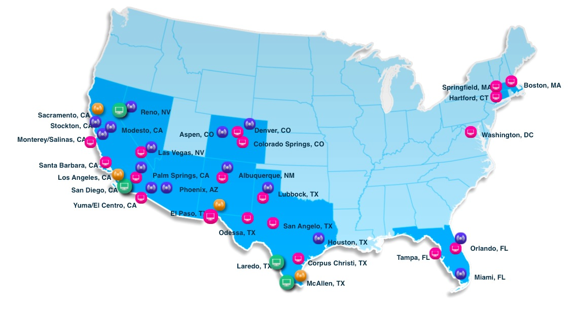
National Cross-Media Footprint
Entravision delivers TV, radio, Internet and mobile across the top U.S. 50 Hispanic markets

Slide 5
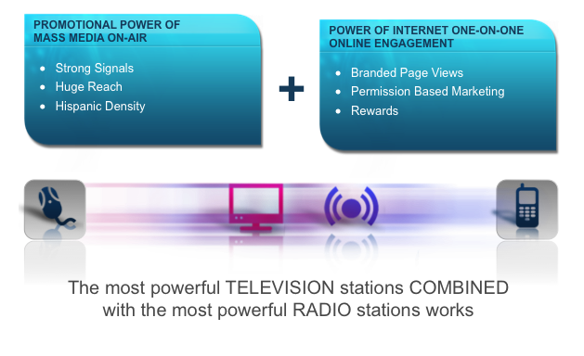
Entravision On-Air, Online, On the Go

Slide 6
Understanding Why Entravision Decided to
Make a Big Data Play
Four main factors influenced this decision:
  Become a data-driven organization
  Hispanic consumers are under represented
  Synergistic opportunity
  New revenue stream

Slide 7

Underserved Market – What We Saw in the Marketplace
Brands are making marketing investment decisions on limited information
No real insights or true performance of program
Targeting assumptions based mostly on survey or sample methods (i.e. “Latinos over-index on mobile usage”)
Campaigns mostly based on just ethnically-coded data
Stereotype approach; they speak Spanish, consume Spanish media, heavy online users…therefore, good target
Little or no cultural relevancy

Slide 8
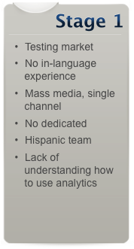
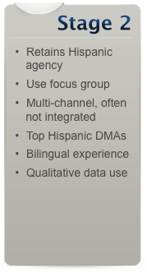
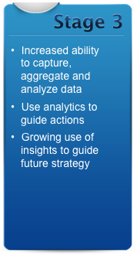
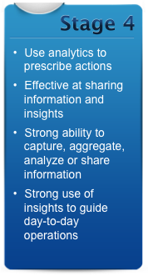
Actionable Insights is an Evolving Process
Evolution of a Marketer into Hispanic Share of Wallet

Slide 9
How is Big Data Synergistic to Entravision?
As a media company with a national presence in major markets, data and analytics is a core component of EVC’s operations
EVC uses both quantitative and qualitative data to support internal and client performance analytics needs
  Campaign response analysis
  Segmentation analysis
  Market analysis
  Marketing and editorial tone
  Digital channels measurements; online display, mobile

Slide 10
Big Data Brings to Entravision High-Value Offering
Ability to more precisely support customers across the entire marketing value chain:
  Move from a media & communications discussion to a business challenge discussion
  Help identify growth opportunity within the Hispanic market
  Improve measurement of Hispanic market investments
  Demonstrate ROI
  Help accelerate growth through empirical data insights
Transformative in the way we approached business and marketing needs
Leverage big data environment and 3rd party data sources across business units

Slide 11
Winning Executive Buy-in Was Critical
It’s was a significant investment and commitment that required CEO vision and support
Developed detailed roadmap for success:
  Prepared comprehensive plan detailing operations, resources, level of investment and implementation path
  We weighted the need for big data as new revenue source for EVC
  We identified “packaged solutions” for a big data offering
  And, we clearly defined how big data fulfilled an underserved market and provided a shift from sample-based research to empirical analytics

Slide 12
Result – Luminar Was Created as a New Entravision Business Unit
New business unit was created dedicated to serving Hispanic-focused analytics and insights

Slide 13
TECHNICAL APPROACH

Slide 14
Luminar Big Data Would Need to Support these Needs
Analytics-as-a-Service platform
Aggregate multiple sources of data from diverse sources
  Licensed data
  EVC data
  Unstructured social data
  Client data
Offer an advanced and unique focused analytics service
  Provide insights into Hispanic consumer behavior
  Targeting customers in retail, financial services, insurance and auto segments
Future offerings
  Platform as a Service
  White Label Services

Slide 15
Importance of Aligning our Vision with the Right Technology Partner
Proven track record – vendor had to have a demonstrable experience in the implementation of big data solutions
Technology agnostic – We needed a technology partner that could help plan and deploy a solution architecture that was not married to any one vendor
Experience with multiple technology providers/suppliers – We needed a partner that could understand the big data landscape now, in 6 moths and 18 months from today
Blended team approach – Our ideal partner had to clearly understand that they would be operating in a blended client/vendor team environment

Slide 16
Deployment Objectives
Build a best-of-breed model based on Luminar requirements
  Take a vendor neutral approach
  Lowest Total Cost of Ownership
  No requirement to integrate with any legacy systems but SQL data migration
Cloud based architecture
Maximize “re-use” of vendor experience in Big Data
Scalability for future data requirements
Data security requirements
Visualization
Start with a “shoestring” approach

Slide 17

Build the Right Foundation for Growth
Impetus lead solution architecture and vendor selection process
We established a solution framework that delivers four client offerings
We architected a solution that defined all major technology Key Performance Indicators (KPIs) and SPOF

Slide 18
Solution Architecture Phased Approach
Phase 1: Architecture and design consulting
Blueprint architecture for a big data analytics solution covering the roadmap for 12 months and 24 months.
  Provide list of candidate solutions and vendors
  Re-use Impetus experience in Big Data such as iLaDaP framework
  Assess building new solution if necessary
Provide deployment options – Public vs Private Cloud, Vendors
Duration: 3-4 weeks
Prepare detailed project plan and proposal for implementation
  Phase 2 - Detailed POC benchmarking
  Phase 3 - Implementation of Big Data Solution

Slide 19
Solution Creation Approach - Steps

Slide 20
Short-list Creation Process
Input to process – Long list of options
  Comprehensive high level evaluation criteria established
Drill down high-level criteria into sub-factors, and assign scores
  Interview vendors on specific capabilities as needed
  At this level scores are not weighted
Create final weighted cumulative score for each option
  Multiply weights and scores against each detailed criteria and add-up
Recommendation of final short-list to proceed with POC
  Add narrative and detailed description of comparison and results
  Provide Pros and Cons of each option

Slide 21
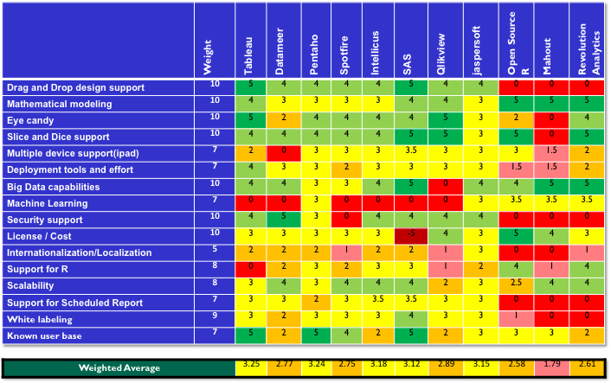
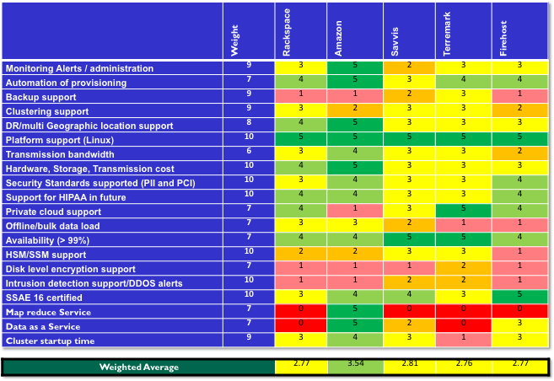
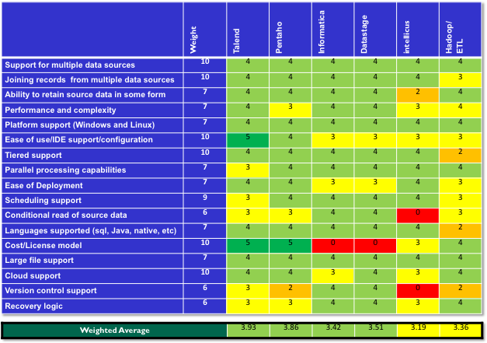



Internal Weighted Evaluation Helped with Vendor Selection Process
We created a custom-scoring matrix used for evaluating vendors pros and cons, defining requirements, and weighting against Luminar’s objectives

Slide 22
Final Result Creation
Input to process
  Bake-off results
Document findings and select winner
Discuss next steps and additional value-adds
  Additional findings discussion
  Data model modifications if any required
  Preparation for production readiness
  Others as discovered during the project execution
After brief break period – submit final documented reports

Slide 23
Defined Performance Metrics Across the Entire Technology Platform
Database
  compute (CPU utilization) & memory used
  storage capacity utilization
  I/O activity
  DB Instance connections
Hadoop
  File system counters
  Map-reduce framework counters
  Sort buffer
Various counters
  Total Memory (RAM)
  Number of CPU cores
  CPU Idle Percentage
  Free Memory, Cache Memory, Swap Memory used
BI/Visualization
  compute (CPU utilization)
  memory used
  layout computations
  No of reports processed
ETL/ELT
  Completed/queued/failed/running tasks
  CPU utilized
  Memory used
  Job start and end time

Slide 24
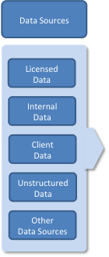
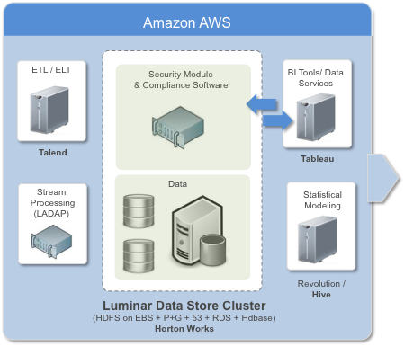
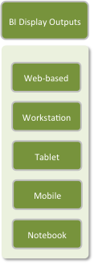
Technology – Hybrid Architecture

Slide 25
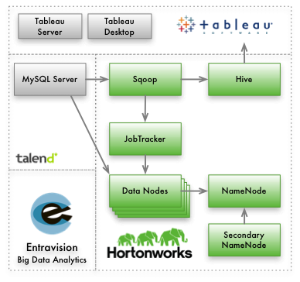
Implemented Solution Overview
Hortonworks as technology integrator
Hadoop Cluster provisioned on Amazon EC2 in under four hours
Original data sets imported from MySQL to HDFS/Hive using Sqoop and Talend
Existing R scripts were modified to work with Hive for data analysis. Minimal code modification required
Tableau work books modified to connect to Hive via Hortonwork’s ODBC driver

Slide 26
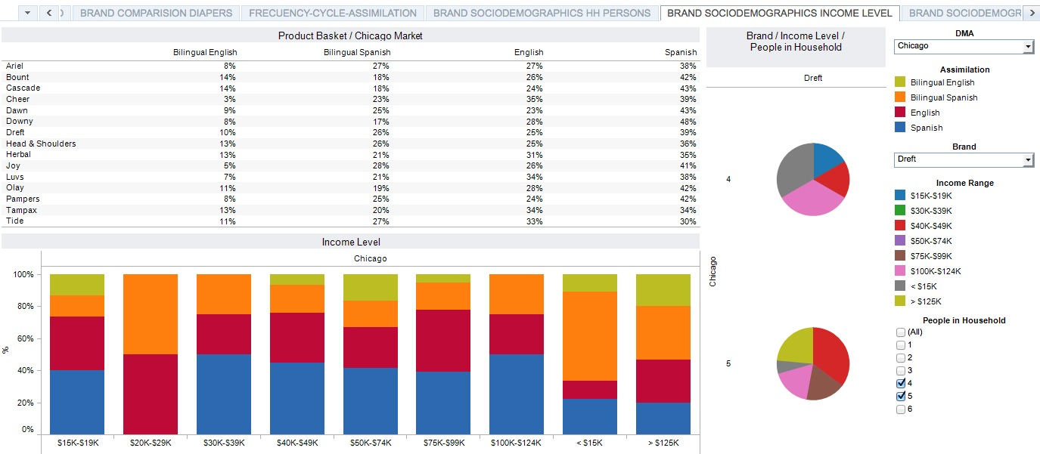
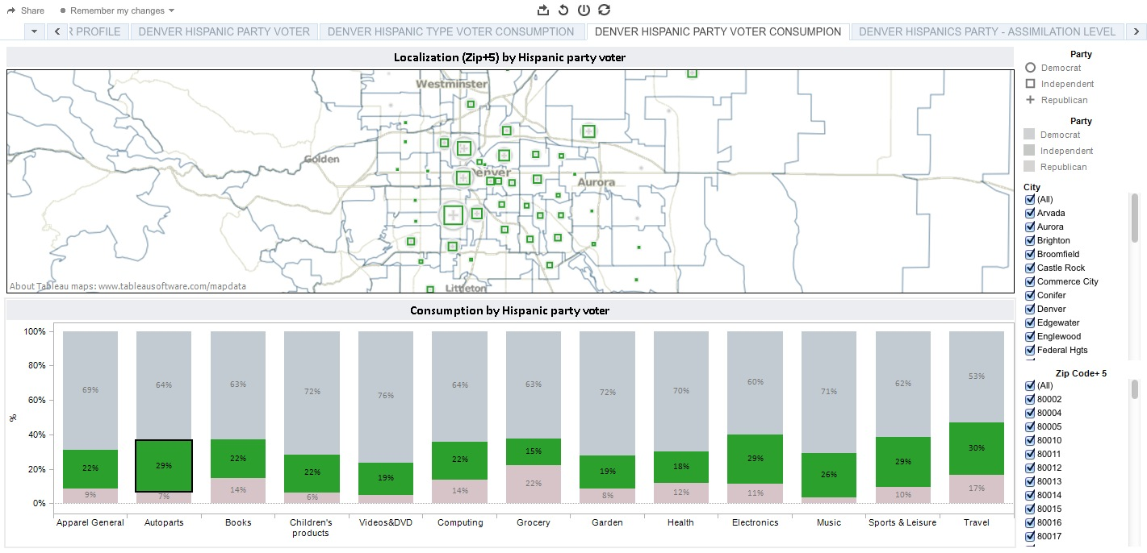
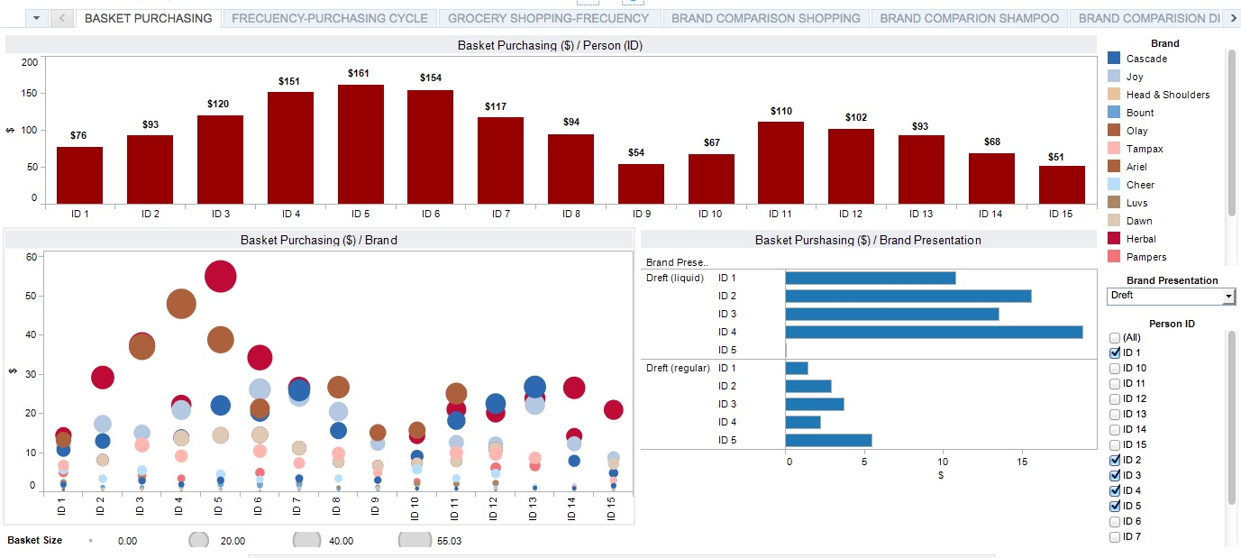
Luminar Business Insights

Slide 27
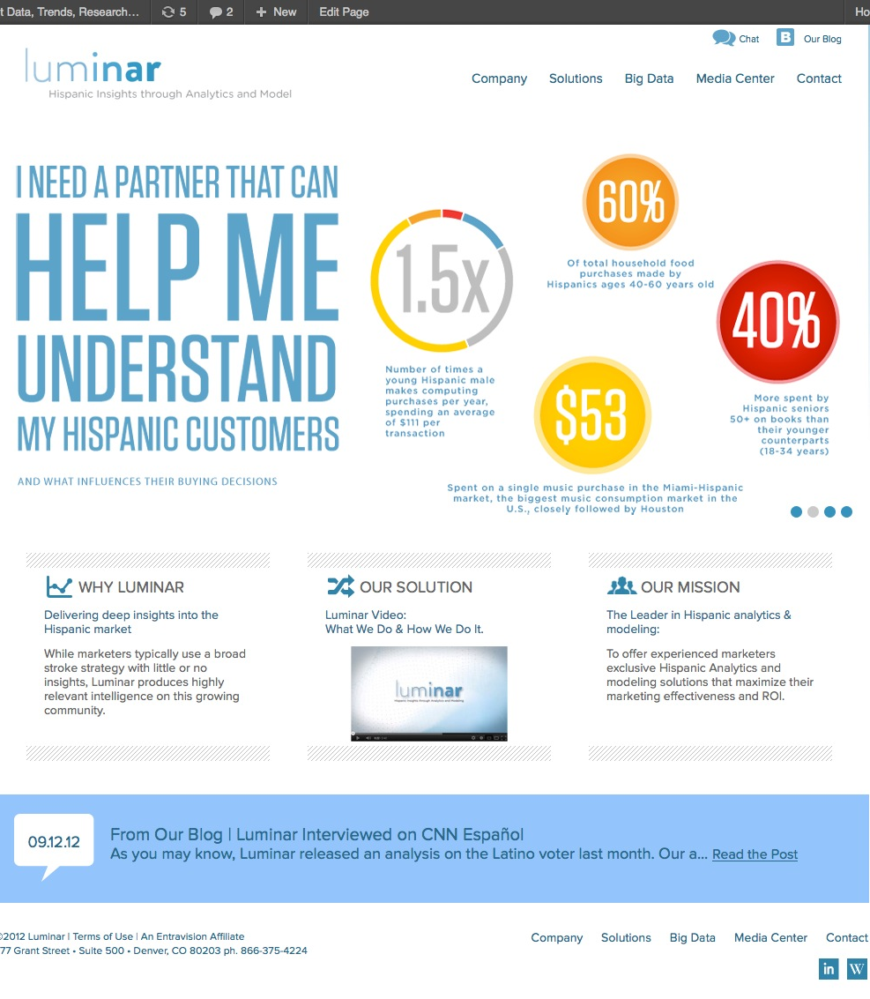


Slide 28


Luminar’s Formula Consists of 3 Core Components

Slide 29
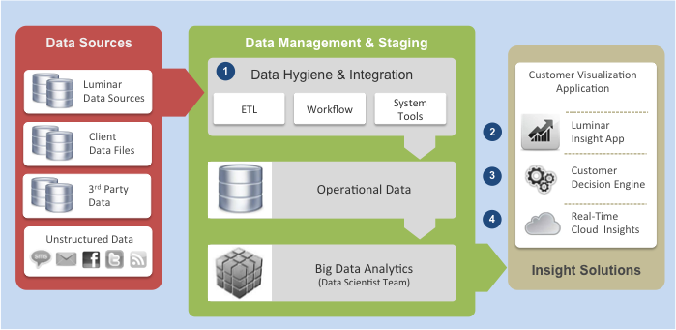
Solution Framework Delivers four Client Offerings

Slide 30
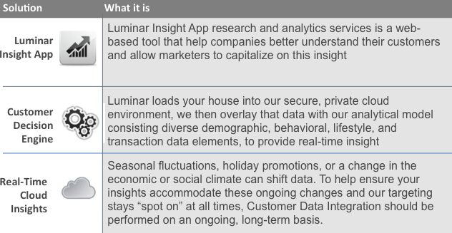
Luminar Rolled Out Four Key Solution Offerings
Business Data, Modeling, and Analytics solutions for:
Growth
Acquisition
Profitability
Retention

Slide 31
Lessons Learned
Having a flexible technology approach helped define the optimum architecture supporting our needs
You cannot do this alone, it’s too complex. Having the right partner was paramount
It’s hard to find talent, don’t be geographically limited
The big data market is still in flux, we opted for best-of-breed solution to support future industry shifts that we anticipate in the next 12-18 months

Slide 32
Closing Remarks…Four Key Takeaways
1
You need to have executive believers in the transformative benefits of Big Data
You must make a “synergistic” connection to your business
Big data can be big headaches…don’t do it alone
Have a flexible approach to your roll-out strategy
Strata “Office Hour” with Oscar Padilla, Franklin Rios & Vineet Tyagi
This Thursday 3:10pm - 4:10pm EDT
Room: Rhinelander North (Table B)
2
3
4

